Slide 1
Chapter 3
Productivity, Output, and Employment

Slide 2
Chapter Outline
The Production Function
The Demand for Labor
The Supply of Labor
Labor Market Equilibrium
Unemployment
Relating Output and Unemployment: Okun’s Law

Slide 3
The Production Function
Factors of production
  Capital (K)
  Labor (N)
  Others (raw materials, land, energy)
  Productivity of factors depends on technology and management

Slide 4
The Production Function
The production function
Y = AF(K, N) (3.1)
  Parameter A is “total factor productivity” (the effectiveness with which capital and labor are used)

Slide 5
The Production Function
Application: The production function of the U.S. economy and U.S. productivity growth
  Cobb-Douglas production function works well for U.S. economy:
Y = A K^{0.3} N^{0.7} (3.2)
  Data for U.S. economy—Table 3.1

Slide 6
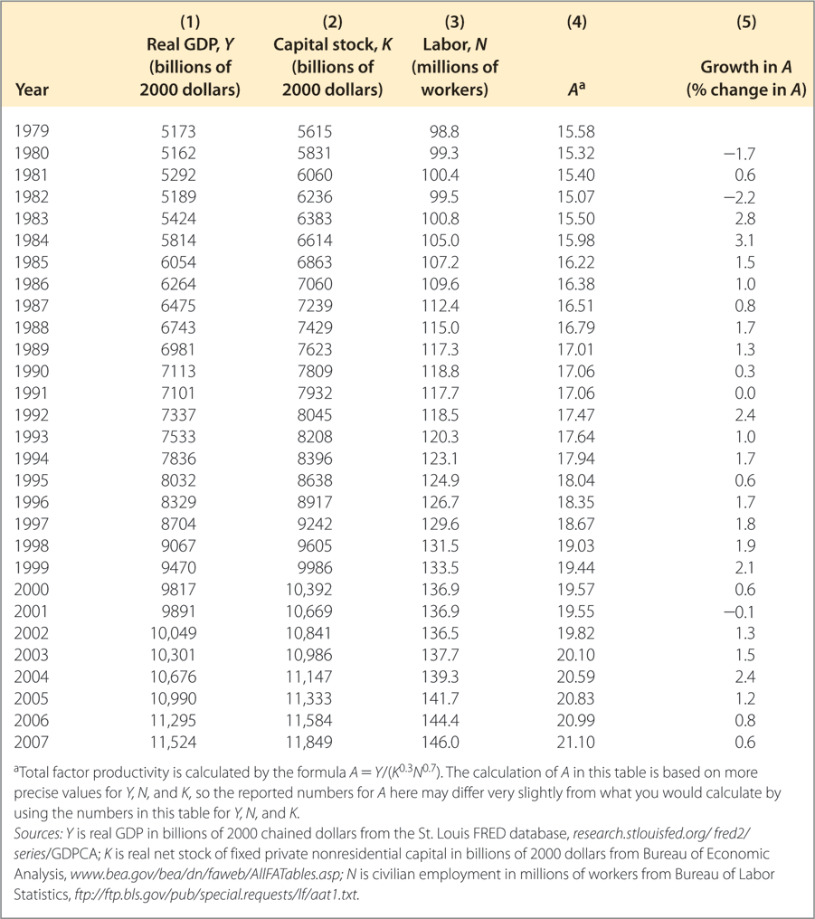
Table 3.1 The Production Function of the United States, 1979-2007

Slide 7
The Production Function
Productivity growth calculated using production function
  Productivity moves sharply from year to year
  Productivity grew slowly in the 1980s and the first half of the 1990s, but increased since the mid-1990s

Slide 8
The Production Function
The shape of the production function
  Two main properties of production functions
    Slopes upward: more of any input produces more output
    Slope becomes flatter as input rises: diminishing marginal product as input increases

Slide 9
The Production Function
The shape of the production function
  Graph production function (Y vs. one input; hold other input and A fixed)
  Figure 3.1

Slide 10
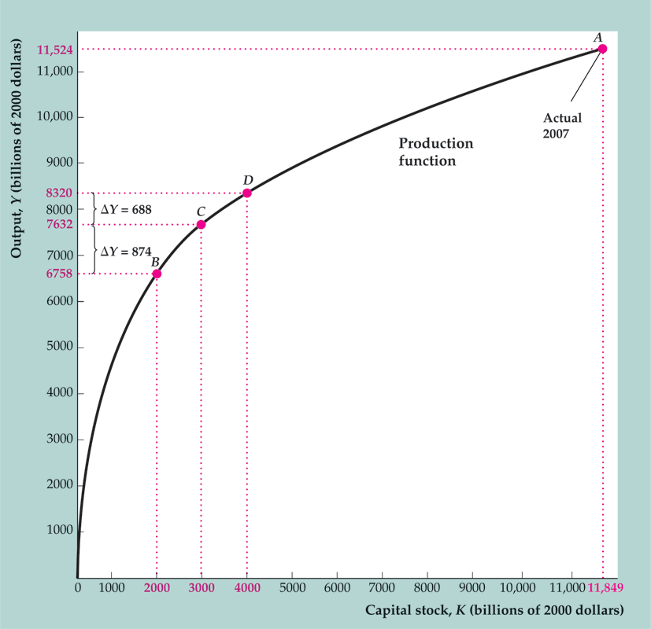
Figure 3.1 The Production Function Relating Output and Capital

Slide 11
The Production Function
The shape of the production function
  Marginal product of capital, MPK = ΔY/ΔK
  Figure 3.2 = Key Diagram 1
    Equal to slope of production function graph (Y vs. K)
    MPK always positive
    Diminishing marginal productivity of capital
    MPK declines as K rises

Slide 12
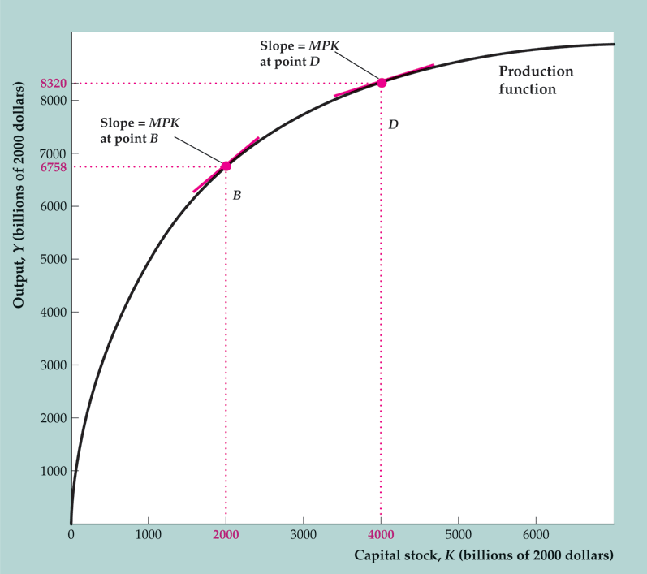
Figure 3.2 The marginal product of capital

Slide 13
The Production Function
The shape of the production function
  Marginal product of labor, MPN = ΔY/ΔN
  Figure 3.3
    Equal to slope of production function graph (Y vs. N)
    MPN always positive
    Diminishing marginal productivity of labor

Slide 14
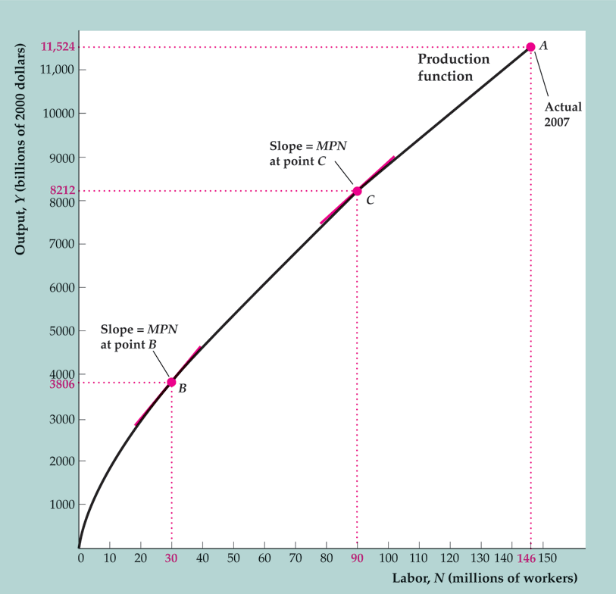
Figure 3.3 The production function relating output and labor

Slide 15
The Production Function
Supply shocks
  Supply shock = productivity shock = a change in an economy’s production function
  Supply shocks affect the amount of output that can be produced for a given amount of inputs
  Shocks may be positive (increasing output) or negative (decreasing output)
  Examples: weather, inventions and innovations, government regulations, oil prices

Slide 16
The Production Function
Supply shocks
  Supply shocks shift graph of production function (Fig. 3.4)
    Negative (adverse) shock: Usually slope of production function decreases at each level of input (for example, if shock causes parameter A to decline)
    Positive shock: Usually slope of production function increases at each level of output (for example, if parameter A increases)

Slide 17
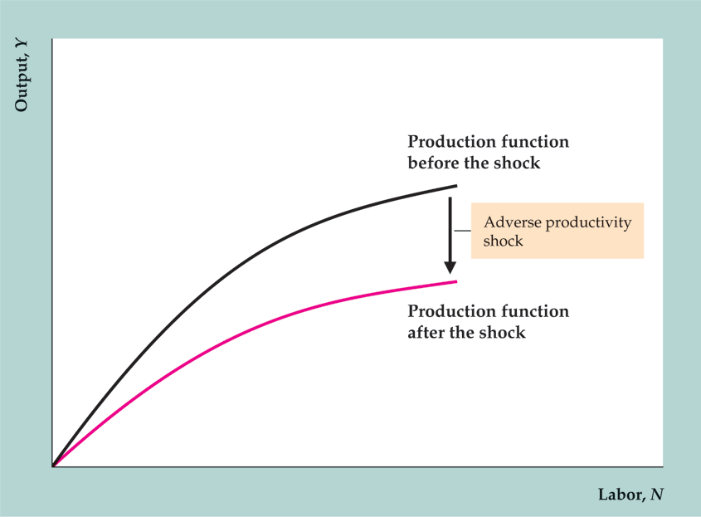
Figure 3.4 An adverse supply shock that lowers the MPN

Slide 18
The Demand for Labor
How much labor do firms want to use?
  Assumptions
    Hold capital stock fixed—short-run analysis
    Workers are all alike
    Labor market is competitive
    Firms maximize profits

Slide 19
The Demand for Labor
The marginal product of labor and labor demand: an example
  Example: The Clip Joint—setting the nominal wage equal to the marginal revenue product of labor
MRPN = P × MPN (3.3)
  W = MRPN is the same condition as w = MPN, since W = P × w and MRPN = P × MPN

Slide 20
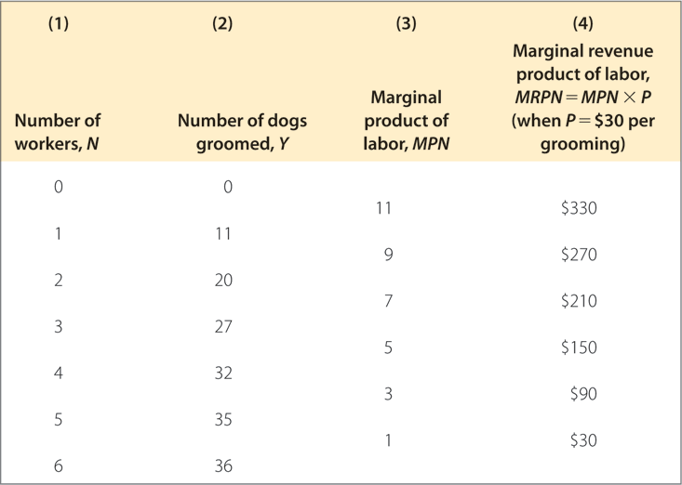
Table 3.2 The Clip Joint’s Production Function

Slide 21
The Demand for Labor
The marginal product of labor and labor demand: an example
  A change in the wage
    Begin at equilibrium where W = MRPN
    A rise in the wage rate means W > MRPN, unless N is reduced so the MRPN rises
    A decline in the wage rate means W < MRPN, unless N rises so the MRPN falls

Slide 22
The Demand for Labor
How much labor do firms want to use?
  Analysis at the margin: costs and benefits of hiring one extra worker (Fig. 3.5)
    If real wage (w) > marginal product of labor (MPN), profit rises if number of workers declines
    If w < MPN, profit rises if number of workers increases
    Firms’ profits are highest when w = MPN

Slide 23
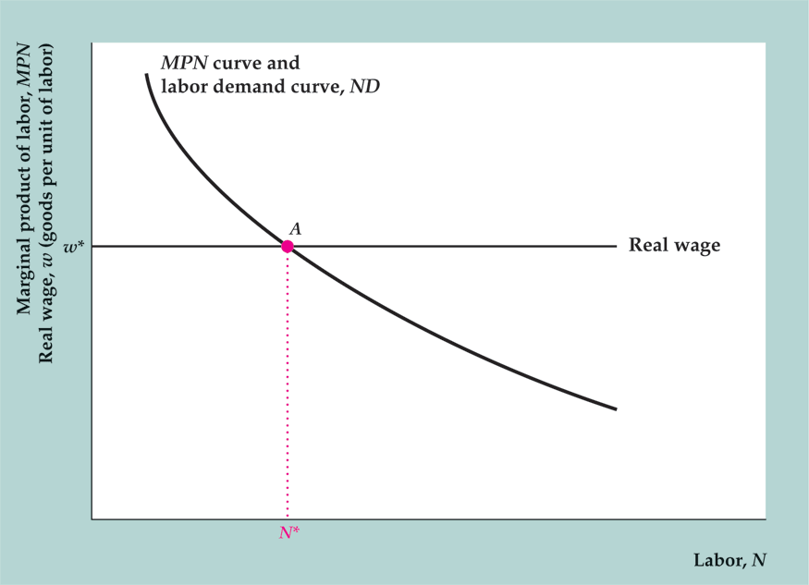
Figure 3.5 The determination of labor demand

Slide 24
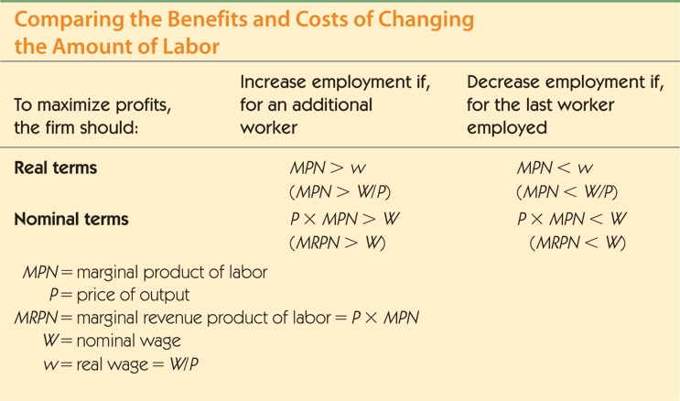
Summary 2

Slide 25
The Demand for Labor
The marginal product of labor and the labor demand curve
  Labor demand curve shows relationship between the real wage rate and the quantity of labor demanded
  It is the same as the MPN curve, since w = MPN at equilibrium
  So the labor demand curve is downward sloping; firms want to hire less labor, the higher the real wage

Slide 26
The Demand for Labor
Factors that shift the labor demand curve
  Note: A change in the wage causes a movement along the labor demand curve, not a shift of the curve
  Supply shocks: Beneficial supply shock raises MPN, so shifts labor demand curve to the right; opposite for adverse supply shock
  Size of capital stock: Higher capital stock raises MPN, so shifts labor demand curve to the right; opposite for lower capital stock

Slide 27
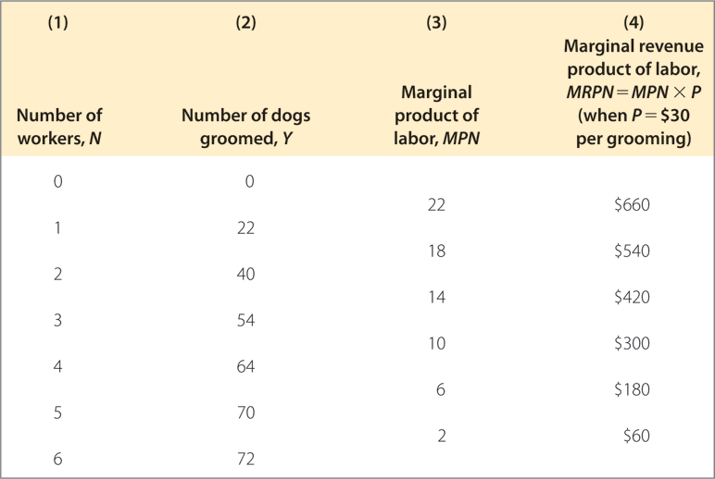
Table 3.3 The Clip Joint’s Production Function After a Beneficial Productivity Shock

Slide 28
The Demand for Labor
Aggregate labor demand
  Aggregate labor demand is the sum of all firms’ labor demand
  Same factors (supply shocks, size of capital stock) that shift firms’ labor demand cause shifts in aggregate labor demand

Slide 29
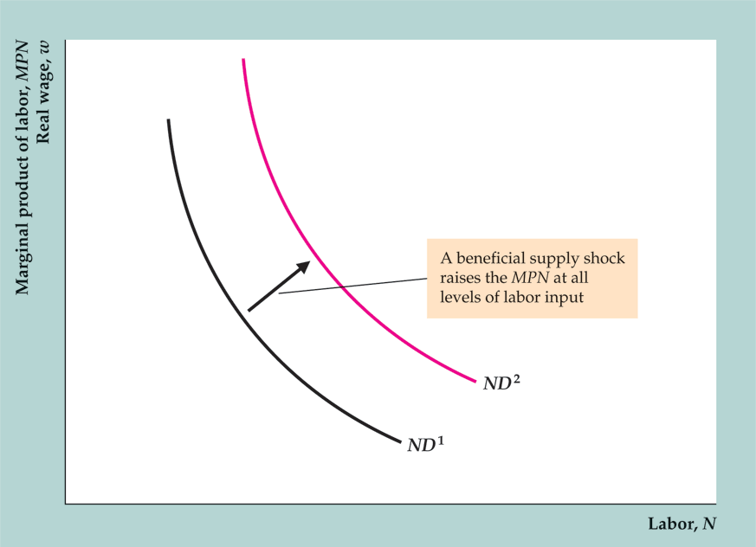
Figure 3.6 The effect of a beneficial supply shock on labor demand

Slide 30
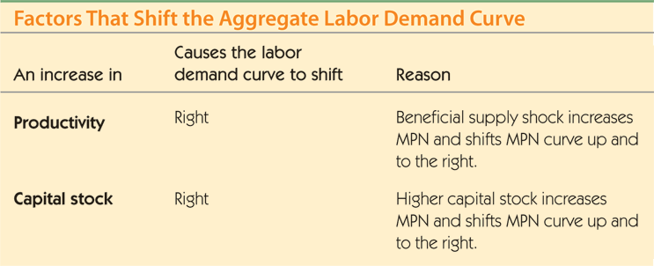
Summary 3

Slide 31
The Supply of Labor
Supply of labor is determined by individuals
  Aggregate supply of labor is the sum of individuals’ labor supply
  Labor supply of individuals depends on labor-leisure choice

Slide 32
The Supply of Labor
The income-leisure trade-off
  Utility depends on consumption and leisure
  Need to compare costs and benefits of working another day
    Costs: Loss of leisure time
    Benefits: More consumption, since income is higher
  If benefits of working another day exceed costs, work another day
  Keep working additional days until benefits equal costs

Slide 33
The Supply of Labor
Real wages and labor supply
  An increase in the real wage has offsetting income and substitution effects
    Substitution effect: Higher real wage encourages work, since reward for working is higher
    Income effect: Higher real wage increases income for same amount of work time, so person can afford more leisure, so will supply less labor

Slide 34
The Supply of Labor
Real wages and labor supply
  A pure substitution effect: a one-day rise in the real wage
  A temporary real wage increase has just a pure substitution effect, since the effect on wealth is negligible

Slide 35
The Supply of Labor
Real wages and labor supply
  A pure income effect: winning the lottery
    Winning the lottery doesn’t have a substitution effect, because it doesn’t affect the reward for working
    But winning the lottery makes a person wealthier, so a person will both consume more goods and take more leisure; this is a pure income effect

Slide 36
The Supply of Labor
Real wages and labor supply
  The substitution effect and the income effect together: a long-term increase in the real wage
    The reward to working is greater: a substitution effect toward more work
    But with higher wage, a person doesn’t need to work as much: an income effect toward less work
    The longer the high wage is expected to last, the stronger the income effect; thus labor supply will increase by less or decrease by more than for a temporary reduction in the real wage

Slide 37
The Supply of Labor
Real wages and labor supply
  Empirical evidence on real wages and labor supply
    Overall result: Labor supply increases with a temporary rise in the real wage
    Labor supply falls with a permanent increase in the real wage

Slide 38
The Supply of Labor
Real wages and labor supply
  The labor supply curve (Fig. 3.7)
    Increase in the current real wage should raise quantity of labor supplied
    Labor supply curve relates quantity of labor supplied to real wage
    Labor supply curve slopes upward because higher wage encourages people to work more

Slide 39
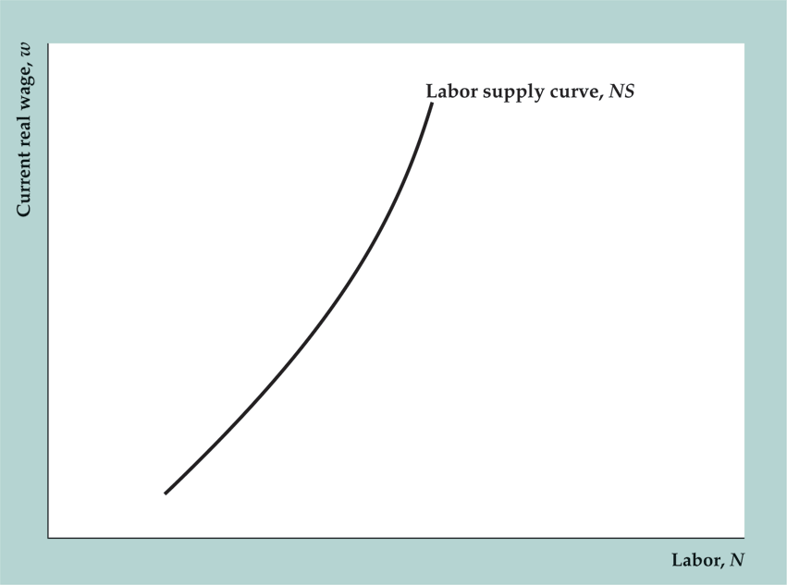
Figure 3.7 The labor supply curve of an individual worker

Slide 40
The Supply of Labor
Factors that shift the labor supply curve
  Wealth: Higher wealth reduces labor supply (shifts labor supply curve to the left, as in Fig. 3.8)
  Expected future real wage: Higher expected future real wage is like an increase in wealth, so reduces labor supply (shifts labor supply curve to the left)

Slide 41
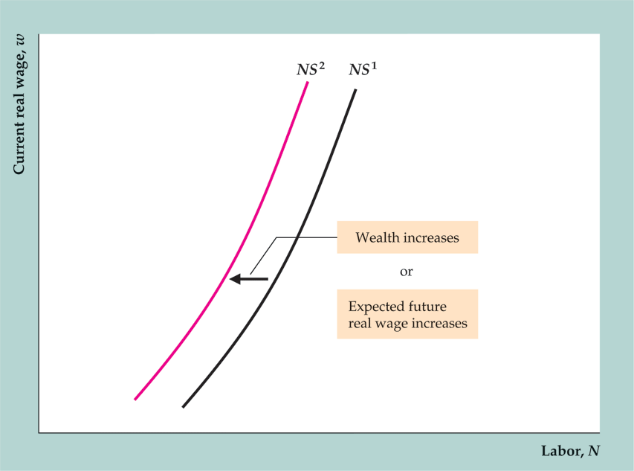
Figure 3.8 The effect on labor supply of an increase in wealth

Slide 42
The Supply of Labor
Aggregate labor supply
  Aggregate labor supply rises when current real wage rises
    Some people work more hours
    Other people enter labor force
    Result: Aggregate labor supply curve slopes upward

Slide 43
The Supply of Labor
Aggregate labor supply
  Factors increasing labor supply
    Decrease in wealth
    Decrease in expected future real wage
    Increase in working-age population (higher birth rate, immigration)
    Increase in labor force participation (increased female labor participation, elimination of mandatory retirement)

Slide 44
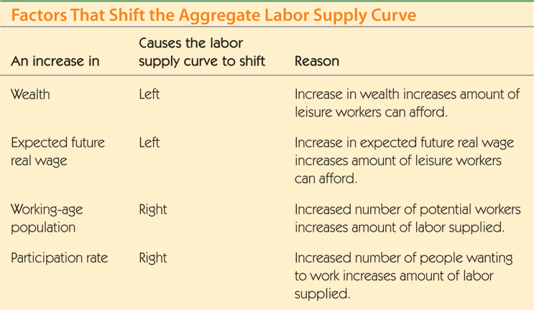
Summary 4

Slide 45
The Supply of Labor
Application: comparing U.S. and European labor markets
  Unemployment rates were similar in the U.S. and Europe in 1970s and 1980s, but are higher in Europe since then (Fig. 3.9)

Slide 46
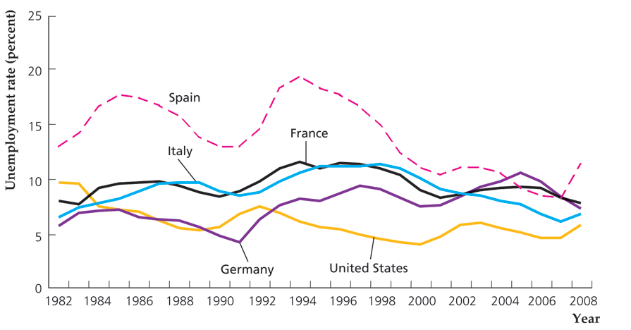
Figure 3.9 Unemployment rates in the United States and Europe, 1982-2008
Source: OECD Factbook 2009, Harmonised Unemployment Rates.

Slide 47
The Supply of Labor
Application: comparing U.S. and European labor markets
  Research: three main reasons for higher unemployment rates in Europe (generous unemployment insurance systems, high tax rates, government policies that interfere with labor markets)

Slide 48
The Supply of Labor
Application: comparing U.S. and European labor markets
  European countries: more generous unemployment insurance
    Replacement rate = fraction of lost wages that a worker receives; higher in Europe than U.S.
    European workers get unemployment benefits for longer, so have incentive to remain unemployed
    The more turbulent economy of 1980s and 1990s led European job losers to take advantage of unemployment insurance system
    Ireland and Netherlands reformed their unemployment insurance systems, and unemployment rates fell significantly

Slide 49
The Supply of Labor
Application: comparing U.S. and European labor markets
  High income-tax rates in Europe also reduce incentive to work
  Government interference in labor markets in Europe affects demand for labor and sometimes supply of labor

Slide 50
Labor Market Equilibrium
Equilibrium: Labor supply equals labor demand
Key Diagram 2
Fig. 3.10

Slide 51
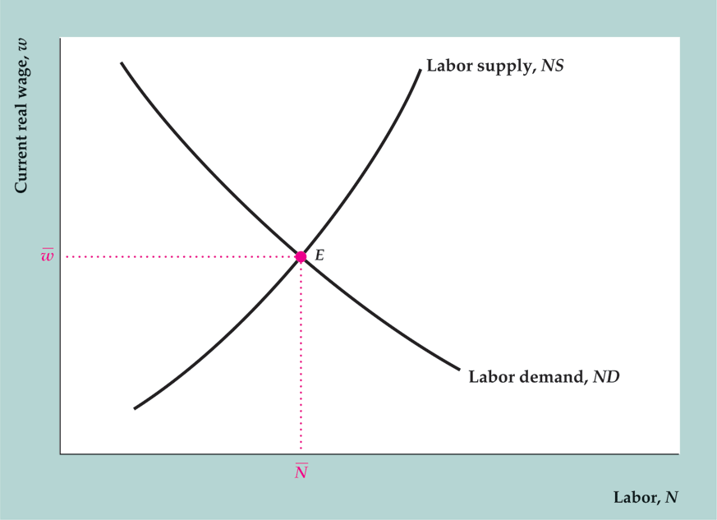
Figure 3.10 Labor market equilibrium

Slide 52
Labor Market Equilibrium
Classical model of the labor market—real wage adjusts quickly
Determines full-employment level of employment and market-clearing real wage
Problem with classical model: can’t study unemployment

Slide 53
Labor Market Equilibrium
Full-employment output
Full-employment output = potential output = level of output when labor market is in equilibrium
(3.4)
affected by changes in full employment level or production function (example: supply shock, Fig. 3.11)

Slide 54
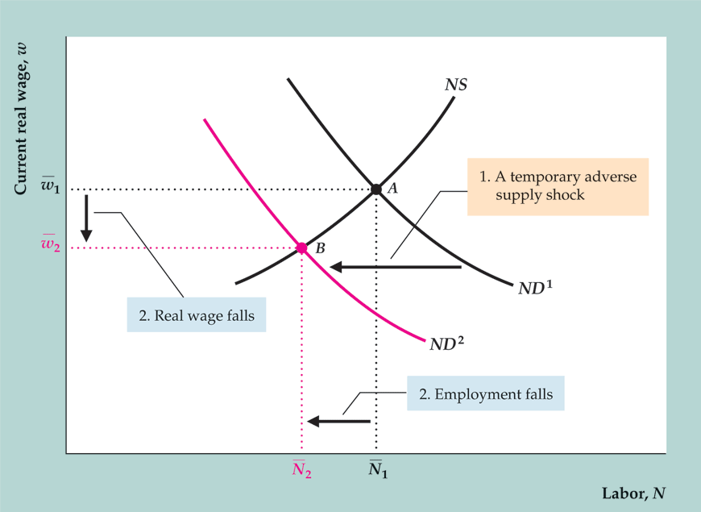
Figure 3.11 Effects of a temporary adverse supply shock on the labor market
Sources: Producer price index for fuels and related products and power from research.stlouisfed.org/fred2/series/PPIENG; GDP deflator from research.stlouisfed.org/fred2/GDPDEF. Data were scaled so that the relative price of energy equals 100 in year 2000.

Slide 55
Labor Market Equilibrium
Application: output, employment, and the real wage during oil price shocks
  Sharp oil price increases in 1973–1974, 1979–1980, 2003–2008 (Fig. 3.12)

Slide 56
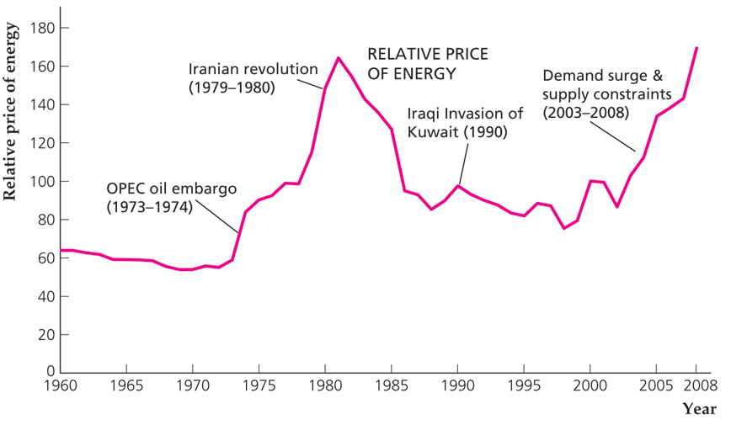
Figure 3.12 Relative price of energy,
1960-2008

Slide 57
Labor Market Equilibrium
Application: output, employment, and the real wage during oil price shocks
  Adverse supply shock—lowers labor demand, employment, the real wage, and the full-employment level of output
  First two cases: U.S. economy entered recessions
  Research result: 10% increase in price of oil reduces GDP by 0.4 percentage points

Slide 58
Unemployment
Measuring unemployment
  Categories: employed, unemployed, not in the labor force
  Labor Force = Employed + Unemployed
  Unemployment Rate = Unemployed/Labor Force
  Participation Rate = Labor Force/Adult Population
  Employment Ratio = Employed/Adult Population
  Table 3.4 shows current data

Slide 59
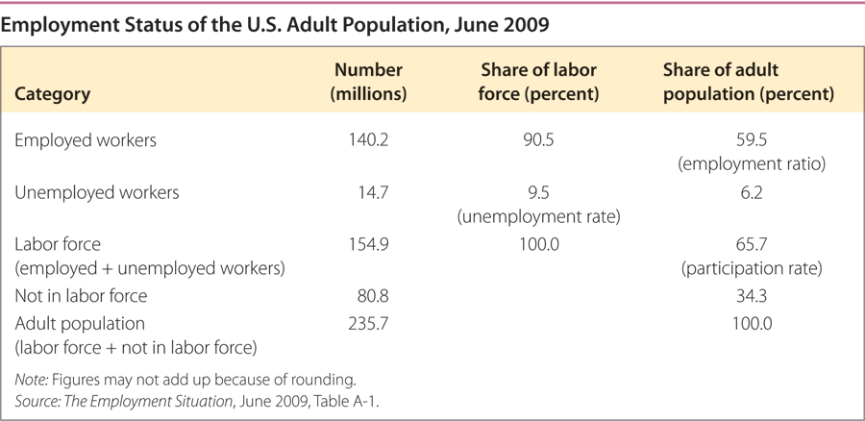
Table 3.4 Employment Status of the U.S. Adult Population, June 2009

Slide 60
Unemployment
Changes in employment status
  Flows between categories (Fig. 3.13)
  Discouraged workers: people who have become so discouraged by lack of success at finding a job that they stop searching

Slide 61
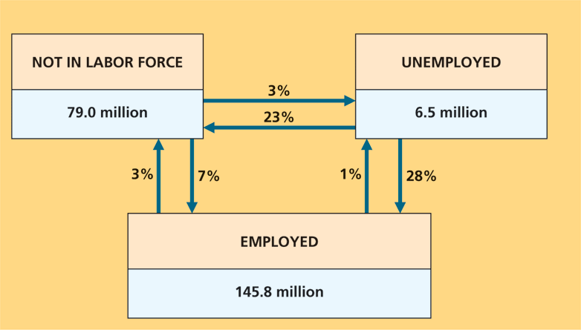
Figure 3.13 Changes in employment status in a typical month (June 2007)

Slide 62
Unemployment
How long are people unemployed?
  Most unemployment spells are of short duration
    Unemployment spell = period of time an individual is continuously unemployed
    Duration = length of unemployment spell
  Most unemployed people on a given date are experiencing unemployment spells of long duration

Slide 63
Unemployment
How long are people unemployed?
  Numerical example:
    Labor force = 100; on the first day of every month, two workers become unemployed for one month each; on the first day of every year, four workers become unemployed for one year each
    Result: 28 spells of unemployment during a year; 24 short (one month), four long (one year); so most spells are short
    At any date, unemployment = six; four have long spells (one year), two have short spells (one month); so most unemployed people on a given date have long spells

Slide 64
Unemployment
Why there are always unemployed people
  Frictional unemployment
    Search activity of firms and workers due to heterogeneity
    Matching process takes time

Slide 65
Unemployment
Why there are always unemployed people
  Structural unemployment
    Chronically unemployed: workers who are unemployed a large part of the time
    Structural unemployment: the long-term and chronic unemployment that exists even when the economy is not in a recession
    One cause: Lack of skills prevents some workers from finding long-term employment
    Another cause: Reallocation of workers out of shrinking industries or depressed regions; matching takes a long time

Slide 66
Unemployment
The natural rate of unemployment ( )
  natural rate of unemployment; when output and employment are at full-employment levels
  = frictional + structural unemployment
  Cyclical unemployment: difference between actual unemployment rate and natural rate of unemployment

Slide 67
Unemployment
In touch with data and research: labor market data
  BLS employment report
    Household survey: unemployment, employment
    Establishment survey: jobs

Slide 68
Relating Output and Unemployment: Okun’s Law
Relationship between output (relative to full-employment output) and cyclical unemployment
(3.5)

Slide 69
Relating Output and Unemployment: Okun’s Law
Why is the Okun’s Law coefficient 2, and not 1?
  Other things happen when cyclical unemployment rises: Labor force falls, hours of work per worker decline, average productivity of labor declines
  Result is 2% reduction in output associated with 1 percentage point increase in unemployment rate

Slide 70
Relating Output and Unemployment: Okun’s Law
Alternative formulation if average growth rate of full-employment output is 3%:
ΔY/Y = 3 – 2 Δu (3.6)
Fig. 3.14 shows U.S. data

Slide 71
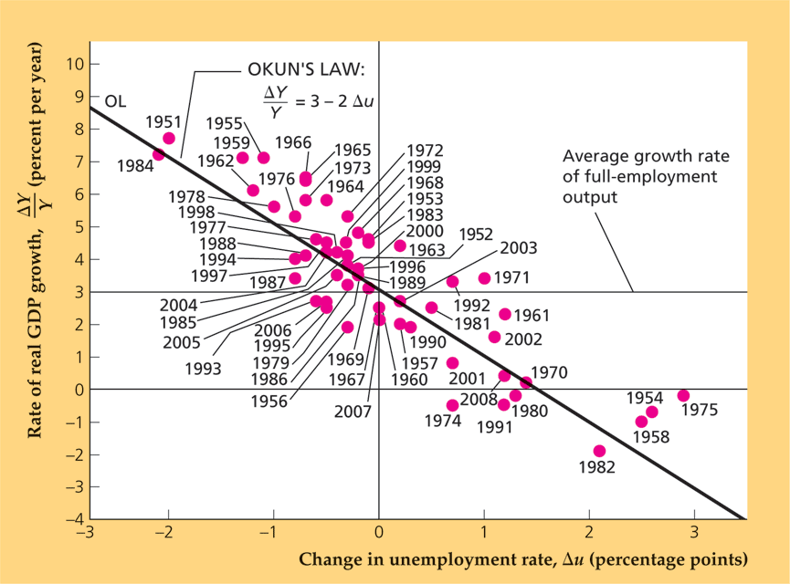
Figure 3.14 Okun’s Law in the United States: 1951-2008
Sources: Real GDP growth rate from Table 1.1.1 from Bureau of Economic Analysis Web site, www.bea.gov/bea/dn/nipaweb. Civilian unemployment rate for all civilian workers from Bureau of Labor Statistics Web site, data.bls.gov.

Slide 72
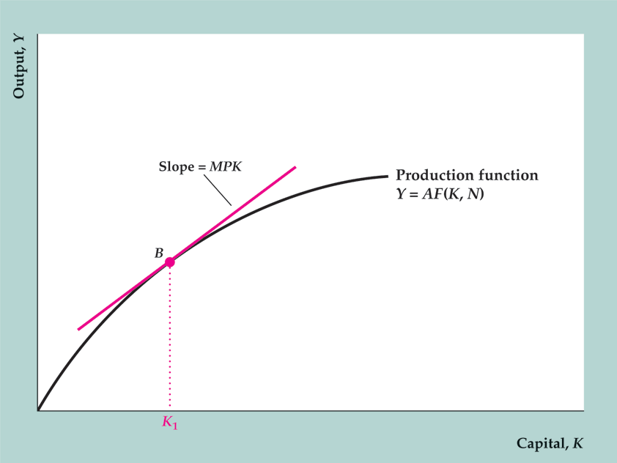
Key Diagram 1 The production function

Slide 73
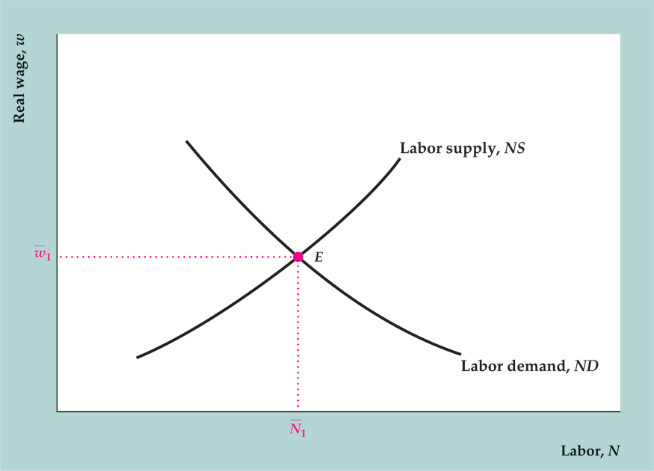
Key Diagram 2 The labor market

